Slide 1

Real-time Modeling of City Events: An Exploration on Seattle’s Public Transportation
Nacho Cano
Sameer Singh
October 2013

Slide 2
Agenda
Objective
OneBusAway
Data
Our work
Visualization
Next Steps
Notes:
With the large amount of sensor-rich, cloud-enabled devices that are carried by people and deployed on public transport vehicles, we now have access to data and resources that allow real-time modeling of local and city wide events.
We present an exploration of such ideas on the Seattle public transportation vehicles' real-time position data collected as part of the OneBusAway project.

Slide 3
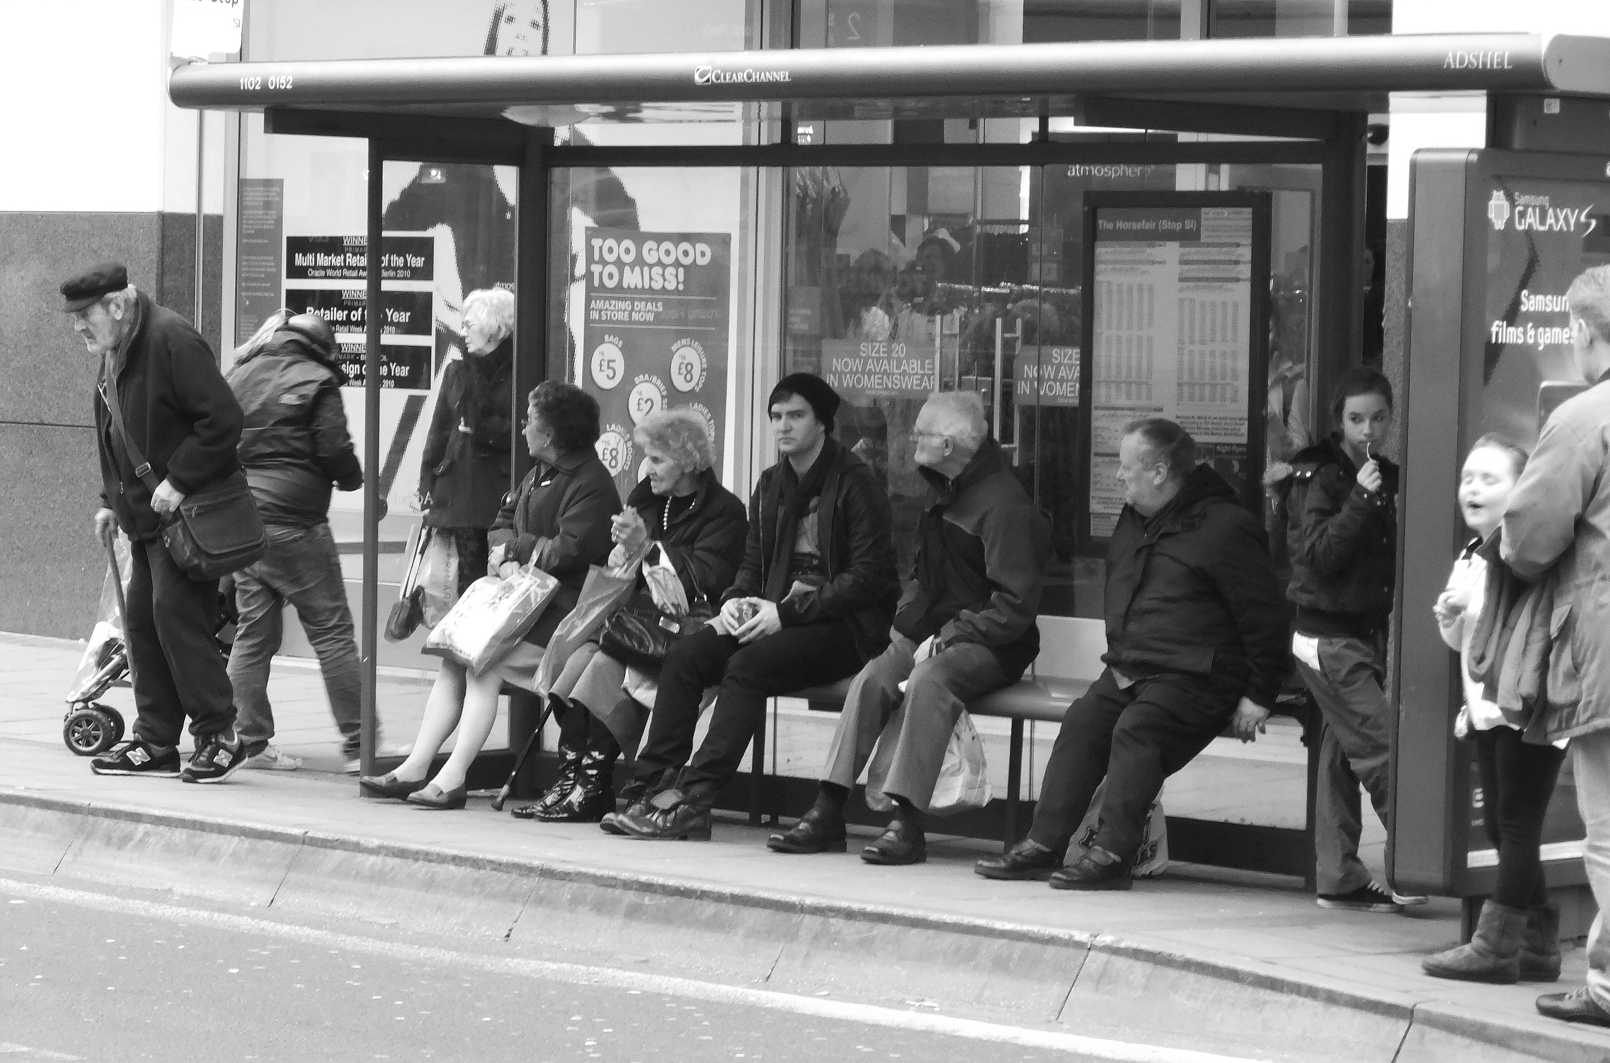
Current Objective
Improve prediction of bus delays, using OneBusAway dataset.
Open Source Real-Time Transit Information System

Slide 4
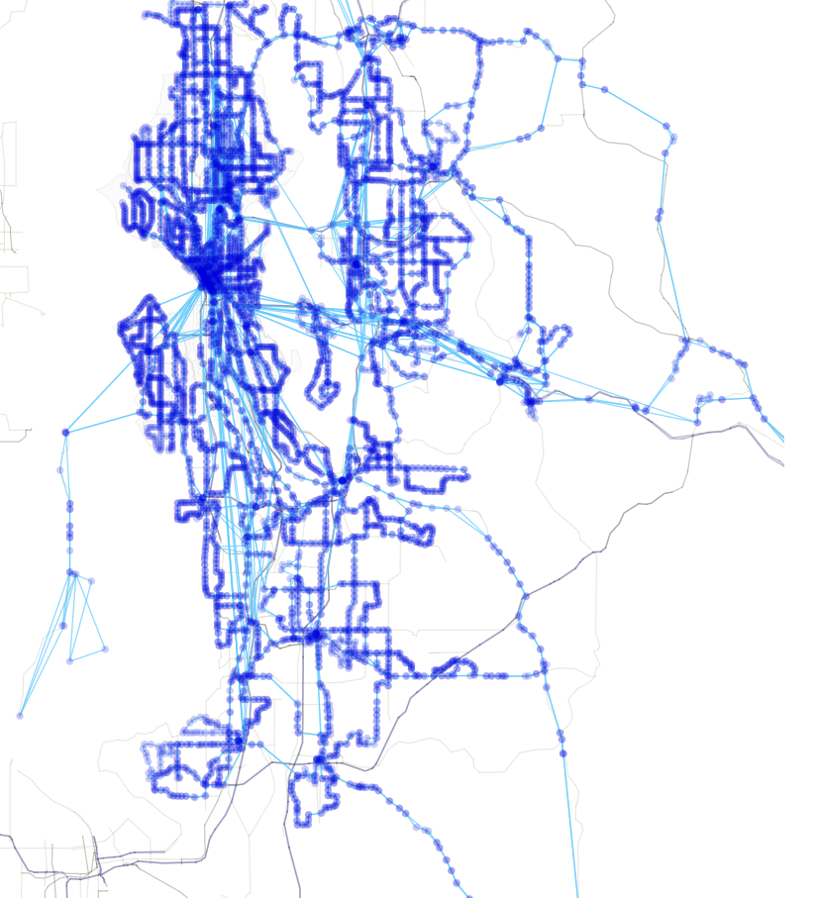
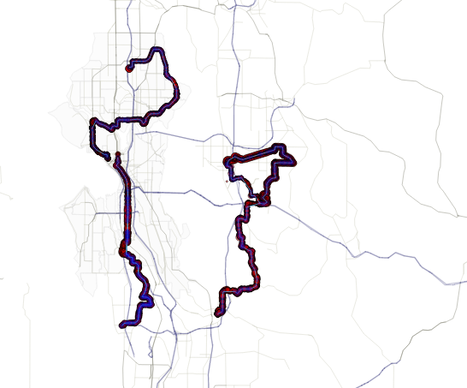
having some visualizations would help us reach the objective… so we start adding some
D3

Slide 5
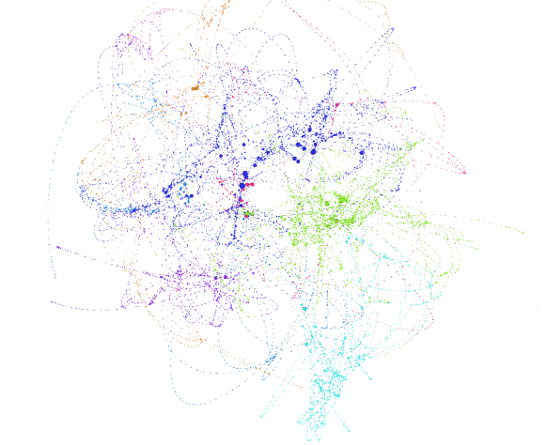
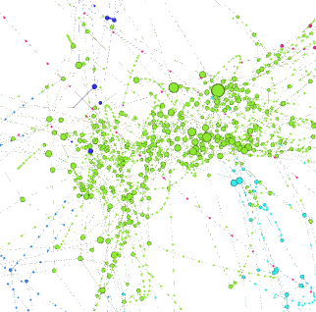
DOT file
(Gephi)

Slide 6
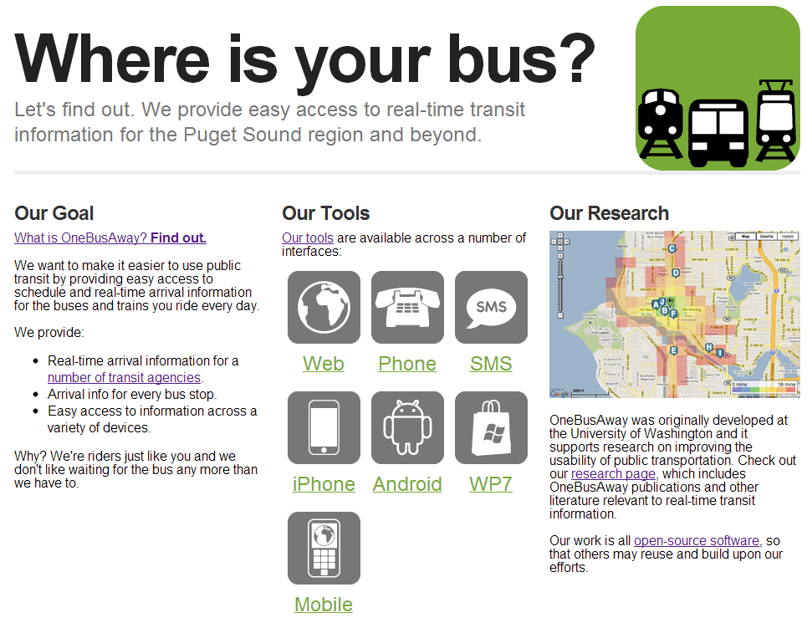
OneBusAway
Originated at UW – Brian Ferris, Kari Watkins
Includes Mobile Apps
Deployments
Production:
Puget Sound Region, WA
New York City, NY
Tampa, FL (Q3 2013)
Detroit, MI (SMS and API only)
Tech Demo:
New Zealand
Atlanta, GA
100,000 users / week
Source: Center for Urban Transportation Research. University of South Florida.
OneBusAway: Sharing real-time transit info. via open-source software.

Slide 7

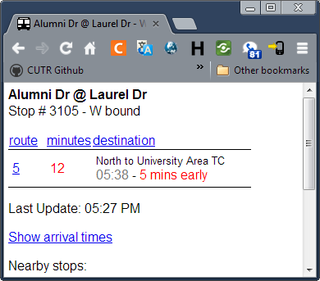
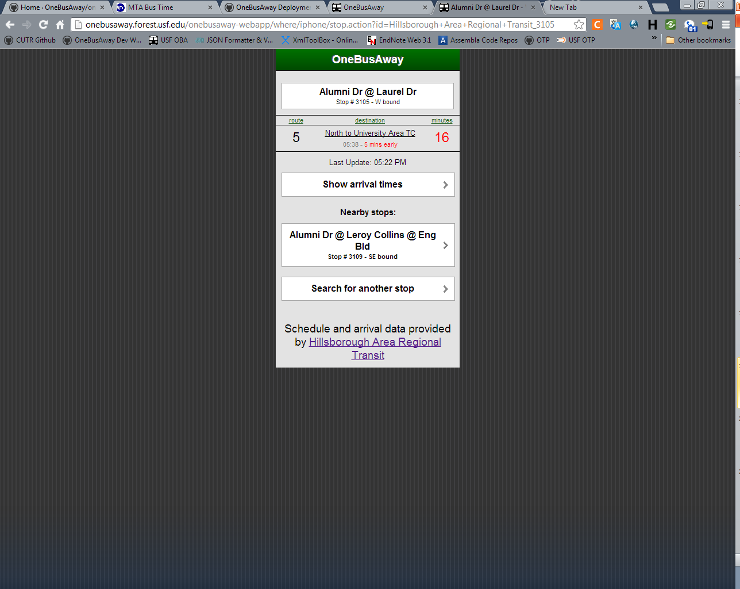
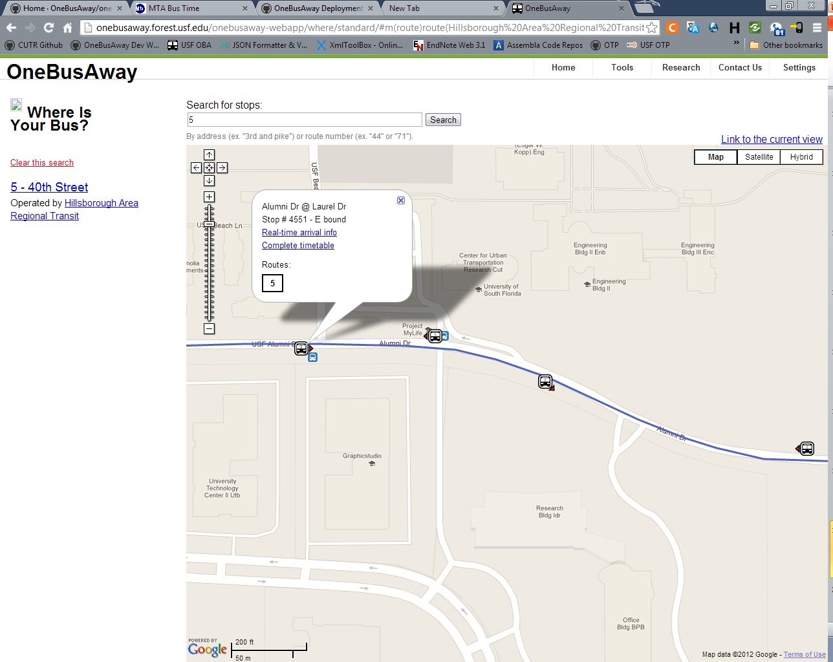
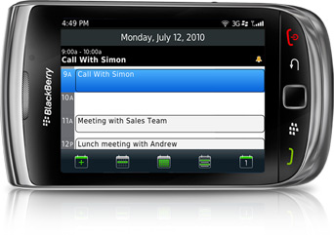
OneBusAway (cont’d)
Desktop browser
Text-only browser
Smartphone browser

Slide 8
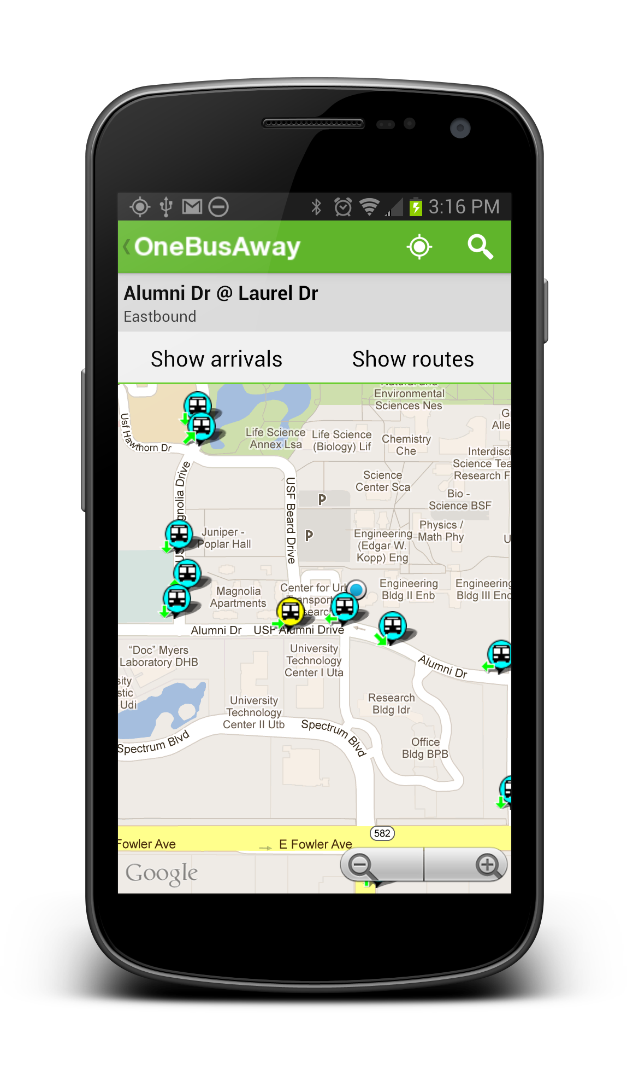

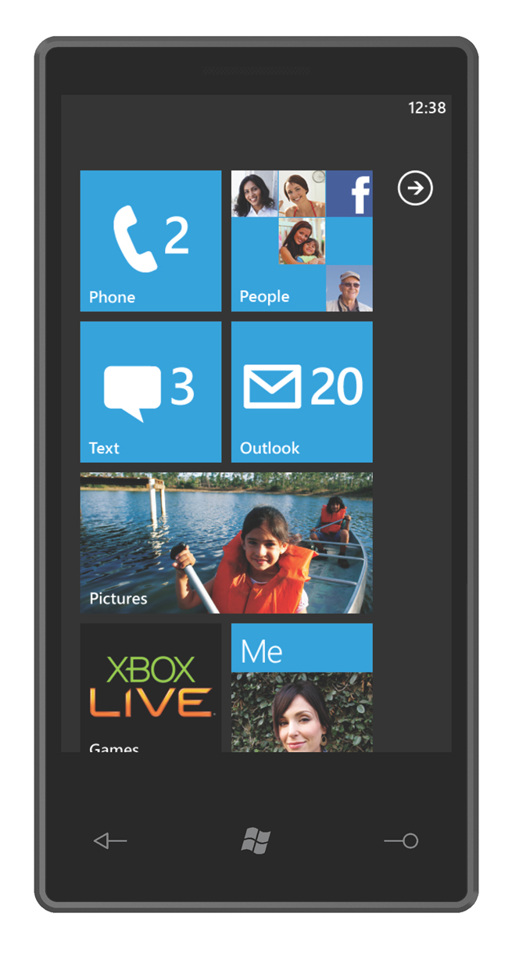
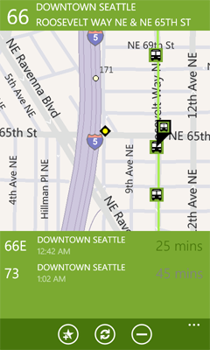
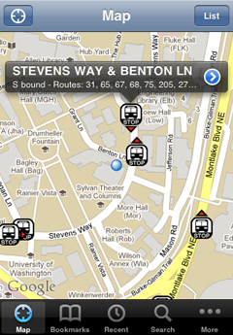



OneBusAway (cont’d)
Android
iPhone
Windows Phone

Slide 9
OneBusAway (cont’d)
Real-time Transit Information
Improve travel methods by enhancing the transit experience
Significant impact on overall bus ridership
Key to reduce perceived wait-times
Source: Benefits of Real-Time Transit Information and the Impacts of Data Accuracy on the Rider Experience, 2012, Gooze, Watkins, Borning.

Slide 10
OneBusAway (cont’d)
Data Errors and their Effect on User Experiences
Level of accuracy that riders expect from real-time information systems
Margin of error (a.k.a error tolerance) riders were willing to accept in their real-time prediction information.
Source: Benefits of Real-Time Transit Information and the Impacts of Data Accuracy on the Rider Experience, 2012, Gooze, Watkins, Borning.

Slide 11

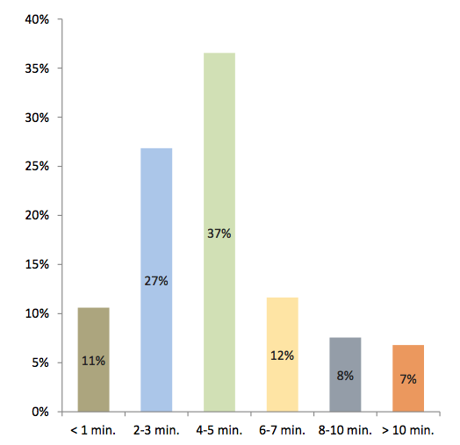
OneBusAway (cont’d)
If a bus arrives earlier or later than when OneBusAway said it would arrive, how many minutes before or after the OneBusAway prediction would you consider it an error?

Slide 12
OneBusAway (cont’d)
Delay Propagation
If the bus is 10 minutes late at point j, OBA will report that the bus will be 10 minutes late at point i (i > j)
Proof by snapshots ☺

Slide 13
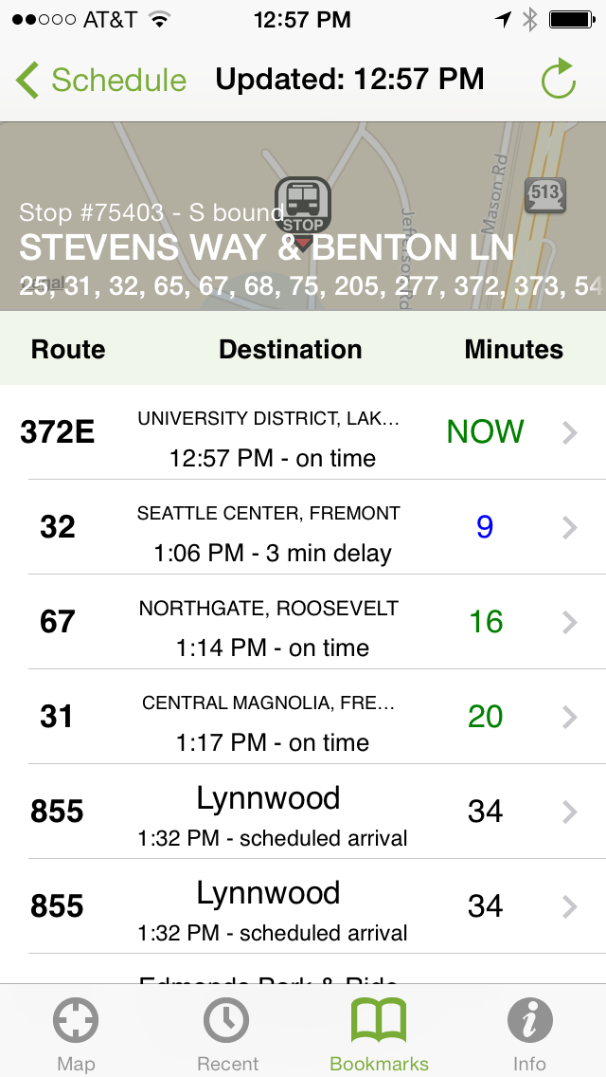
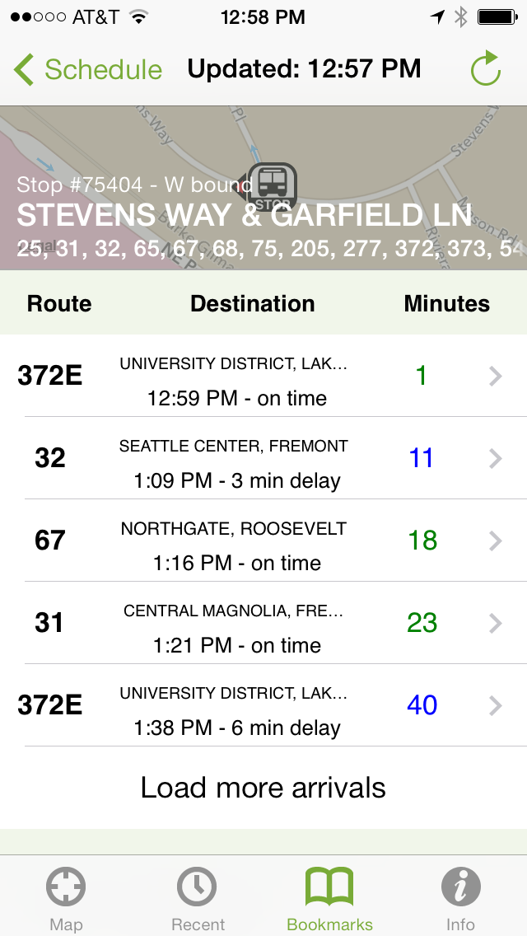
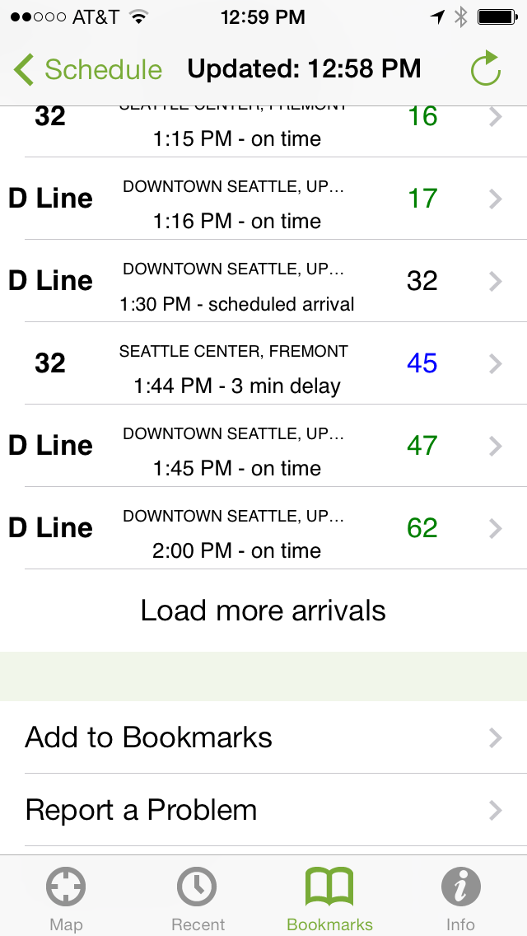
OBA Delay Propagation (cont’d)

Slide 14
Let’s start with the Data
What is the data?
Noise in the data?
How much data is there?

Slide 15
What is the Data?
- One Bus Away data:
- Real-time data
- Some derived fields (e.g. distance along trip)
Static data
Open standard across govt

Slide 16
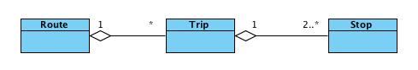
What is the Data? (cont’d)
Some terminology
32
23451
Benton LN
Segment: distance between 2 consecutive stops
Block: consists of 2 or more sequential trips made using the same vehicle.
Trip Instance: an instantiation of the trip. E.g. the trip 23451 of October 30th.

Slide 17
What is the Data? (cont’d)
GTFS
route { id, name, agency_id }
trip { id, service_id, trip_id, headsign, block_id }
stop { id, name, latitude, longitude, description }
stop_time { trip_id, stop_id, arrival_time, stop_sequence }

Slide 18
What is the Data? (cont’d)
OBA Dump (preprocessed)
realtime_position {
timestamp, service_date, trip_id, distance_along_trip, sched_dev, latitude, longitude
}

Slide 19
Noise in the Data
- The Pole Problem: occurs at the beginning and end of trips that belong to the same block. If there’s a layover between trips, that break time is added to the schedule deviation, both on the current trip and on the next one in the block, until the vehicle pulls forward the first stop of the new trip.
Source: Alireza Garakani’s notes
Notes:
Layover: chunk of time that a vehicle is scheduled to sit before the next trip starts-
Ali’s explanation:
There is something called the "pole problem" that causes a lot of lies to be told.
Imagine that a vehicle is ending a trip at a stop that has a layover before the next trip starts.
There are circumstances where the vendor software doesn't see the trip as having ended. Maybe the bus reports a position that is short distance from the position of the final stop, sitting their waiting for the layover to end.
In this event, the schedule deviation accumulates and is attributed to both the current not-detected-to-have-ended trop as well as, in full, the next trip in the block. Imagine that the first trip was running on time and was followed by a layover of 20 minutes. The arrival prediction downstream will be reported as 20 minutes late until the vehicle pulls forward to the first stop, at which point it will go to zero.

Slide 20
Noises in the Data (cont’d)
Sometimes vehicles do not report real-time data because they are in urban canyons or in bus tunnels.
Timetables change three times a year. Within each of these service periods, there may be minor alterations every other week (i.e. the schedule data is off).
Temporary reroutes will fail to be reflected in the static feed or continue to be reflected long after they are over.

Slide 21
Noises in the Data (cont’d)
Modifications due to special events are not reflected in the static feed (e.g. during UW breaks, many trips are cancelled. Even worse, the trips that do run do so with changed trip ids.

Slide 22

How Much Data is there ?
du -ch | grep total = 25GB
more than 2.5 years of OBA dumps.
239 Routes
26319 Trips
8107 Stops

Slide 23
Our Work
Accurately predict arrival times at stops
Predict delays introduced by each segment in the network
Predict the delay k segments ahead (we expect to beat OBA here).

Slide 24
Our Work (cont’d)
Exploring, understanding, cleaning and organizing the data (RDBMS)
Cool Visualizations
No fancy models yet ☹

Slide 25

Some Pre-work…
We don’t have the arrival times at stops. We need to estimate them…
Linear interpolation

Slide 26
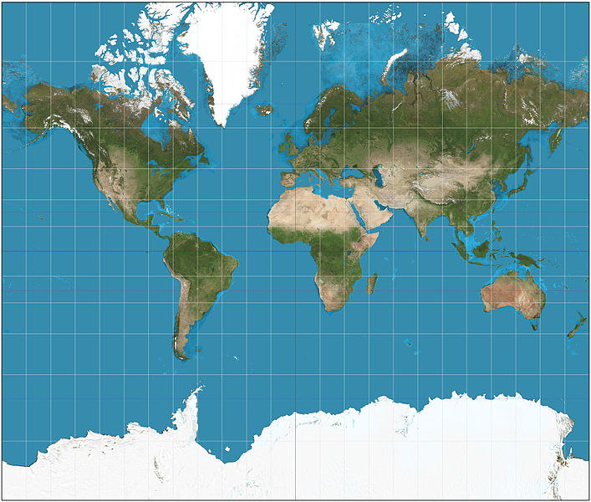
Mercator Projection
Project latitude and longitude to xy axis in order to calculate distances. We used the Mercator projection.

Slide 27
Arrival Time at Stops
Using the positions of all trip instances of a given trip, estimate the distance along trip of a stop.
Once we have the distance along trip of the stop, pick the two closest points -before and after- and interpolate the time.
Notes:
First Approach… Using the positions of a single trip instance of a given trip, pick the two closest points -using euclidean distance- and interpolate the time

Slide 28
ATaS (cont’d)
xs, ds_hat
di, xi
dj, xj
di, ti
ds, ts_hat
dj, tj
Notes:
- di 532.264884008822 - ds 556 - dj 581.043648010236
- di 940.854132452369 - ds 983 - dj 1026.79766892499
- di 1149.49953285287 - ds 1167 - dj 1185.87840042452
- di 1408.71447391037 - ds 1411 - dj 1414.82086790848
- di 1693.51391208119 - ds 1745 - dj 1797.85438584033
- di 2152.94514164867 - ds 2175 - dj 2196.18382333632

Slide 29
Initial Model
Features:
Distance
TimeOfDay
DayOfWeek
MonthOfYear
SegmentIds
TripIds
Y: additional delay on this segment
(scheduledTo – scheduleFrom) – (actualTo - actualFrom)

Slide 30
Initial Model (cont’d)
We ran Linear Regression (least squares) and we got some numbers…
But FIRST, let me show you some stuff that we used…

Slide 31
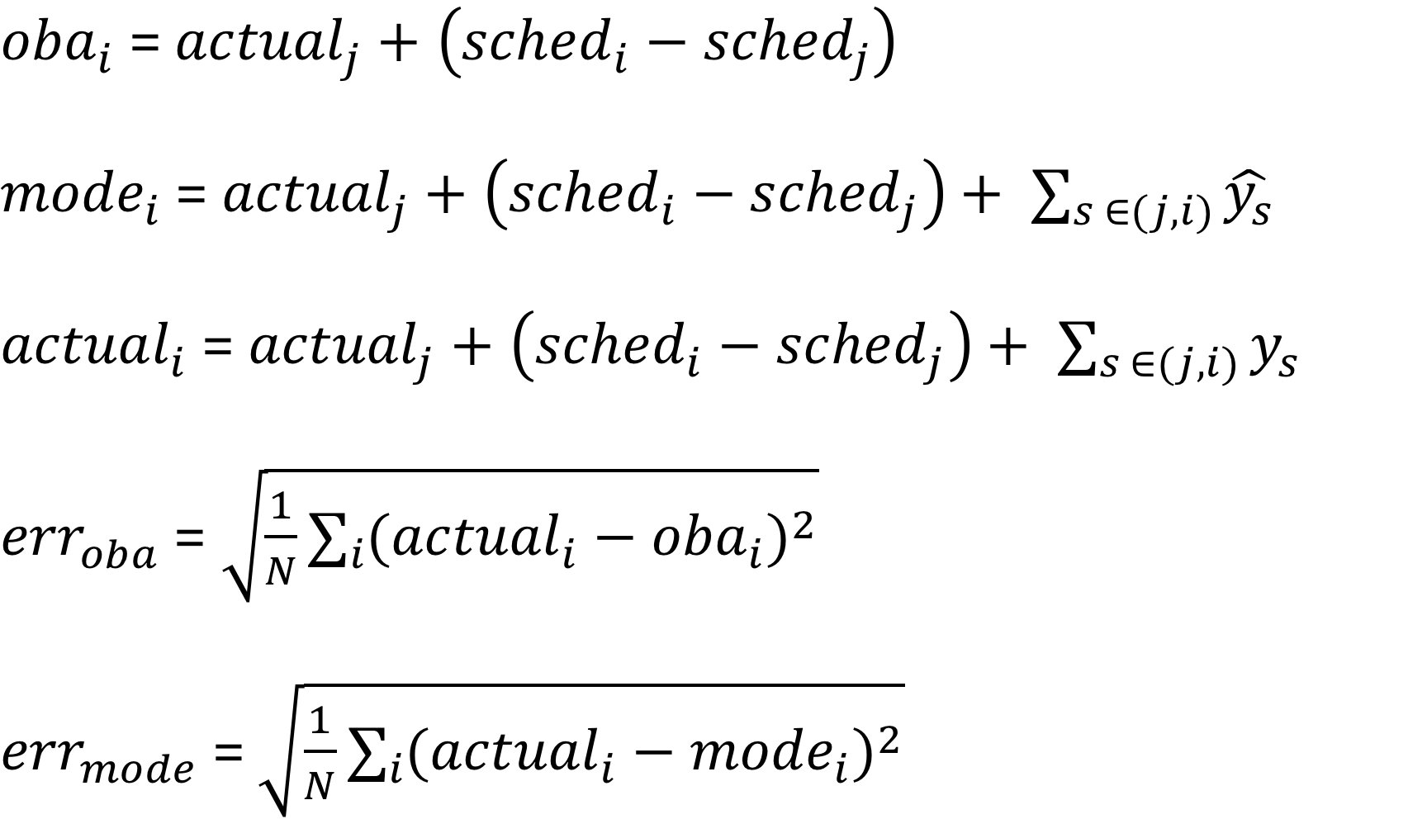
s1
K = 3
s2
s3

Slide 32
Preliminary Results
For Trip 21767755 – Route 132
Features: distance, dayOfWeek, monthOfYear and segmentIds.
Xtrain = 2012 – Aug 2013
Xtest = Sept 2013 – October 2013
Xtrain dataPoints ~ 12000
Xtest dataPoints ~ 1200
K = 1
RMSE Mode Test 60.84 seconds → ~ 1 min
RMSE OBA Test 70.34 seconds → ~ 1 min 10 seconds

Slide 33
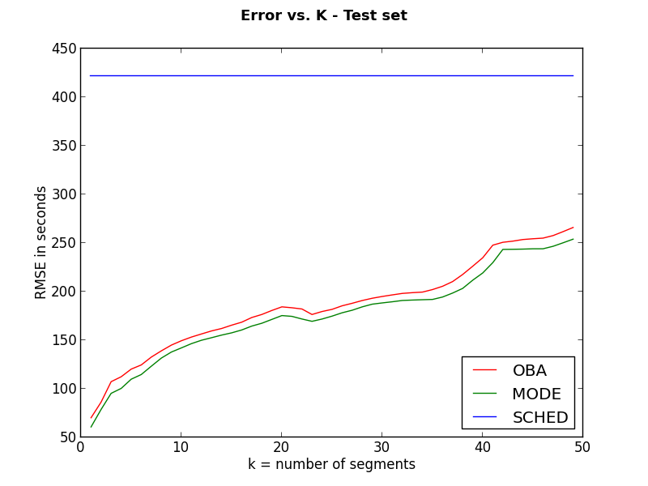
Preliminary Results
Projection for up to 50 K’s
7 min
4 min
1 min

Slide 34
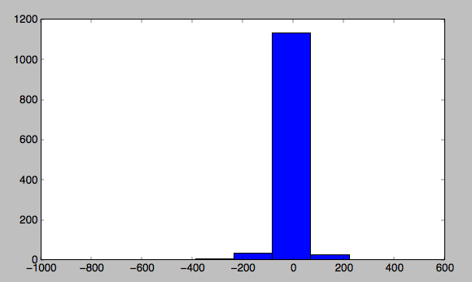
Preliminary Results
Y – Yhat Histogram

Slide 35
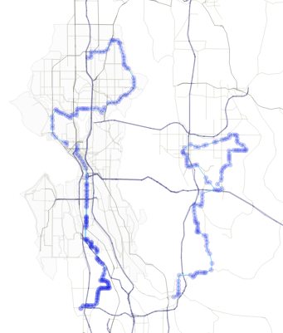
Visualization
Show D3
Show Gephi

Slide 36
Next Steps
Compute congestion on segments from previous trips and routes
Keep on understanding the data
Visualize places with biggest errors
Debug, debug and debug

Slide 37

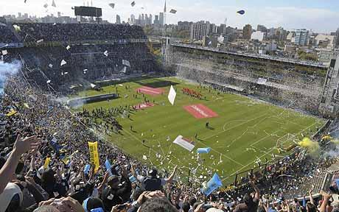
Next Steps (cont’d)
- Include data from different sources (police alerts, weather reports, accidents info, special events, etc.) in order to, for example, indicate why a bus was delayed X amount of minutes.

Slide 38
Next Steps (cont’d)
Anomaly detection
and the most important…
What features would you use?

Slide 39
Thanks !!!

